Slide 1

CRIME RATE PREDICTION AND TREND ANALYSIS
Master of Computer Applications (Integrated)
Semester- VII
Machine Learning Research Project
(050123707)

Slide 2
Group No: IMCA_7_26 Internal Guide: Prof.Khushali Vala
Project By:(TNR-28)
Faizan Memon
D-31 (21018501210031)
Naved Mmeon
D-33 (21018501210033)
Mo. Aasim Saiyed
D-55 (210185501210055)

Slide 3

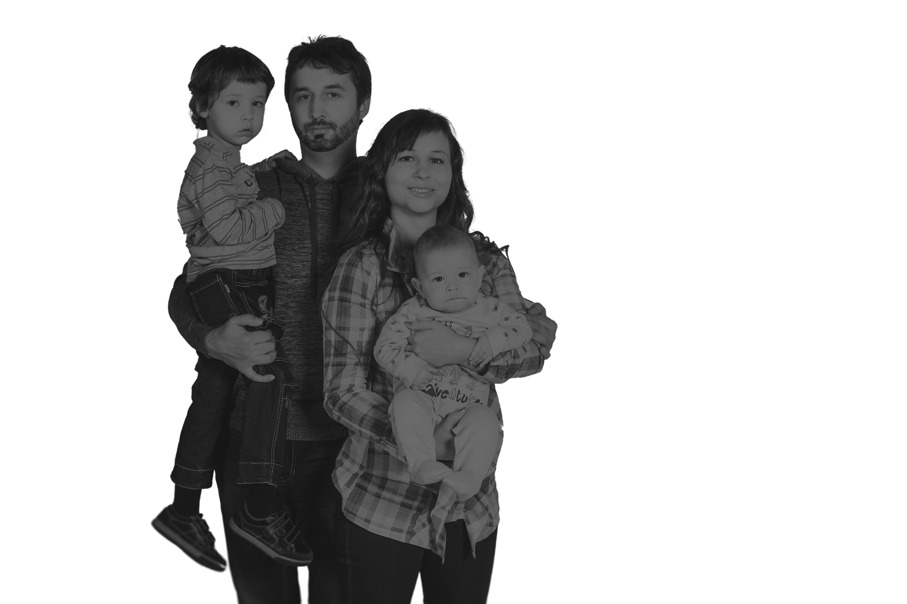


CRIME RATE PREDICTION
AND TREND ANALYSIS
IMCA_7_26
CRIME RATE PREDICTION
10.11.2024

Slide 4



CONTENTS
1. Introduction
1.1 Abstract
1.2 Project Profile
1.3 Problem Statement
1.4 Objective
2. Organization of Data
2.1 Data Source
2.2 Data Category
2.3 Data Description
2.4 Data Volume
2.5 Tools Techniques
CRIME RATE PREDICTION
10.11.2024

Slide 5
CONTENTS
3. Data Visualization(Original Data)
3.1 Distributed Graph
3.2 Line Graph
3.3 Pair Plot
4. Data Cleaning
5. Data Visualization(Descriptive analysis)(Clean Data)
5.1 Hypothesis Definition
5.2 Implementation of Hypothesis
6. Modeling(Predictive)
6.1 Model Identification
6.3 Data Preprocessing
6.2 Model Implementation
6.3 Prediction Results
7. Conclusion
CRIME RATE PREDICTION
10.11.2024

Slide 6
INTRODUCTION
CRIME RATE PREDICTION
10.11.2024

Slide 7


1. Introduction
Crime rates are increasing across many Indian cities, creating significant challenges for law enforcement agencies. Traditional methods of crime prevention are no longer enough to address this issue. However, the vast amount of crime data now available offers an opportunity to better understand and predict crime trends. By analyzing this data, authorities can gain insights into where and when crimes are more likely to occur, allowing for more effective responses and proactive crime prevention. Despite the availability of data, transforming it into actionable insights for predicting future crimes remains a challenge. Without the right tools, law enforcement often reacts after crimes occur rather than preventing them. This project aims to predict crime rates and analyze trends in various Indian cities by studying past crime data. The goal is to identify patterns that can help law enforcement improve resource allocation, develop effective crime prevention strategies, and guide policymakers in creating data-driven solutions to enhance public safety.
CRIME RATE PREDICTION
10.11.2024

Slide 8
1.1 Abstract
This project looks at crime patterns in India by studying past crime data. By analysing trends and using predictive models, it aims to find the main factors that affect crime rates. It uses different types of data, like the kind of crime, the weapon used, the location, details about the victim, and how the police responded, to predict future crime trends. The main goal is to predict crime rates for the next few years and understand crime trends over time.
CRIME RATE PREDICTION
10.11.2024

Slide 9
1.2 Project Profile
Project Title | CRIME RATE PREDICTION
Project Developer | Memon Faizan (Eno. 21018501210031) Memon Naved (Eno. 21018501210033) Saiyed Mo. Aasim (Eno. 21018501210055)
Hardware Require | Pentium 4 Micro Processor or Above RAM 1 GB or Above Hard Disk 60 GB or Above
Software Require | Window 7 or Above
Application Use | Jupyter Notebook
Other Tools | MS Word 365 (Documentation) MS PowerPoint (Presentation)
Project Internal Guide | Prof. Khushali Vala
Duration | 2 Months
CRIME RATE PREDICTION
10.11.2024

Slide 10
1.3 Problem Statement
As crime rates in India continue to grow, predicting crime patterns has become harder due to increasing population and the complexity of cities. Law enforcement agencies often struggle to plan and use their resources effectively because they lack accurate ways to predict where and when crimes might happen. Existing methods do not use past crime data well enough to forecast future trends. This project aims to solve that by analysing historical data to predict future crime rates and trends, helping authorities better prepare and improve public safety
CRIME RATE PREDICTION
10.11.2024

Slide 11
1.4 Objective
The main goals of this project are to:
Study how crime rates have changed over time in India.
Find out the key reasons why some areas have higher crime rates.
Create a model that can predict future crime rates.
Understand crime patterns better and offer useful insights to help law enforcement prepare and respond more effectively.
CRIME RATE PREDICTION
10.11.2024

Slide 12
ORGANIZATION OF DATA
Various graphs and Data Visualization techniques
CRIME RATE PREDICTION
10.11.2024

Slide 13

2. Organization of data
2.1 Data Source
The dataset used for this project was collected from public crime records reported across various cities in India. The dataset includes details from 2020 onwards, encompassing multiple types of crimes, cities, and law enforcement responses. Sources include official government crime data portals, police departments, and public records.
https://www.kaggle.com/datasets/sudhanvahg/indian-crimes-dataset
CRIME RATE PREDICTION
10.11.2024

Slide 14
2.2 Data Category
The Dataset is divided into several important categories that help in analysing crimes:
Crime Type: Groups crimes into different categories like identity theft, homicide, kidnapping, burglary, and vandalism.
Geographic Data: Shows city-based data to highlight where crimes happen in different areas.
Victim Information: Includes details about victims' age and gender to understand which groups are more vulnerable.
Weapon Involvement: Lists the types of weapons used in crimes, which helps determine the seriousness of the offenses.
CRIME RATE PREDICTION
10.11.2024

Slide 15
2.3 Data Description
Columns Name | Description
Date Reported | The date when the crime was initially reported to the authorities.
City | The city where the crime occurred.
Crime Code | A unique identifier or code assigned to categorize the type of crime.
Crime Description | A detailed description of the crime that was committed.
Victim Age | The age of the victim at the time of the crime.
Victim Gender | The gender of the victim (e.g., Male, Female, Other).
Weapon Used | The type of weapon (if any) that was used to commit the crime.
Crime Domain | The specific domain or category under which the crime falls (e.g., violent, cyber).
Police Deployed | The number of police officers deployed in response to the crime.
Case Closed | Indicates whether the case is closed (Yes/No).
Date Case Closed | The date when the case was officially closed.
CRIME RATE PREDICTION
10.11.2024

Slide 16
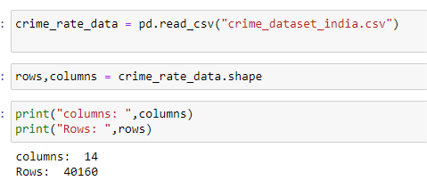
2.4 Data Volume
The code checks the size of the dataset, which has 40,160 rows and 14 columns.
CRIME RATE PREDICTION
10.11.2024

Slide 17
2.5 Tools and Technique
Tools
Jupyter Notebook
Microsoft Word
Microsoft Excel
Techniques
Numpy
Pandas
Matplotlib.pyplot
Microsoft PowerPoint
Seaborn
Sklearn
plotly.express
CRIME RATE PREDICTION
10.11.2024

Slide 18

DATA VISUALIZATION
CRIME RATE PREDICTION
10.11.2024

Slide 19
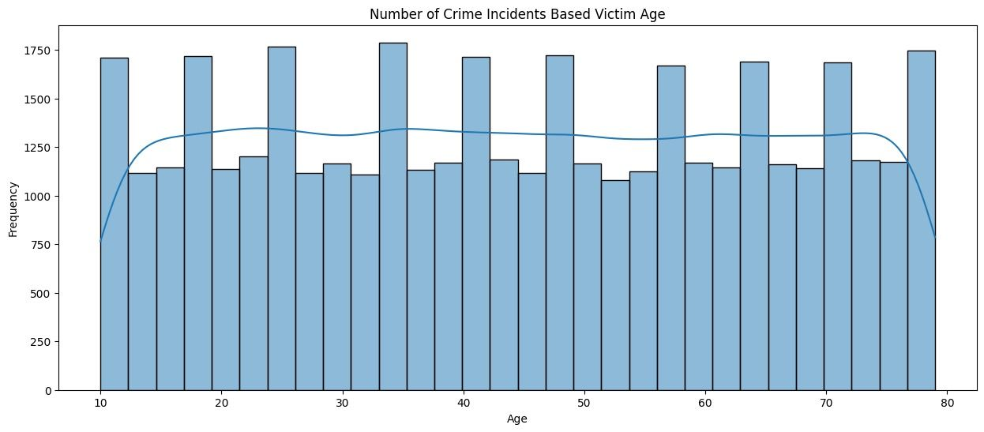
3. Data Visualization(Original Data)
3.1 Distributed Graph:
Crime Incidents Based on Victim Age:
CRIME RATE PREDICTION
10.11.2024

Slide 20
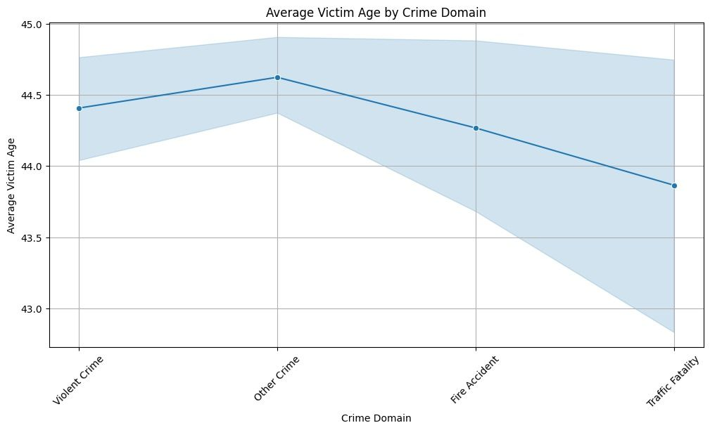
3.2 Line Graph
Average Victim Age by Crime Domain:
CRIME RATE PREDICTION
10.11.2024

Slide 21
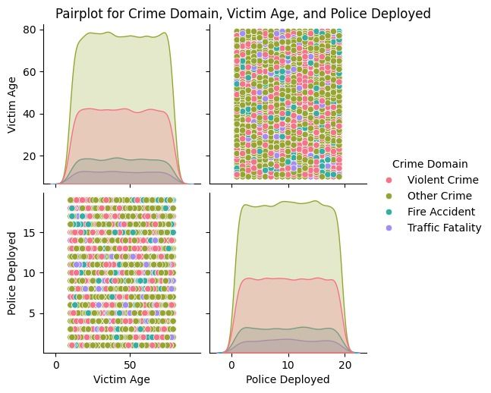
3.3 Pair Plot:
Crime Domains Based on Victim Age and Police Deployment:
CRIME RATE PREDICTION
10.11.2024

Slide 22
DATA CLEANING
REMOVING NULL VALUES AND UNWANTED DATA
CRIME RATE PREDICTION
10.11.2024

Slide 23
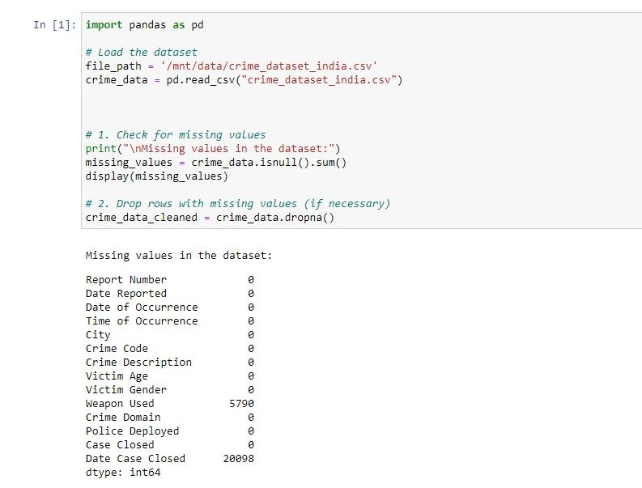
4. Data Cleaning
Checking for null values:
CRIME RATE PREDICTION
10.11.2024

Slide 24
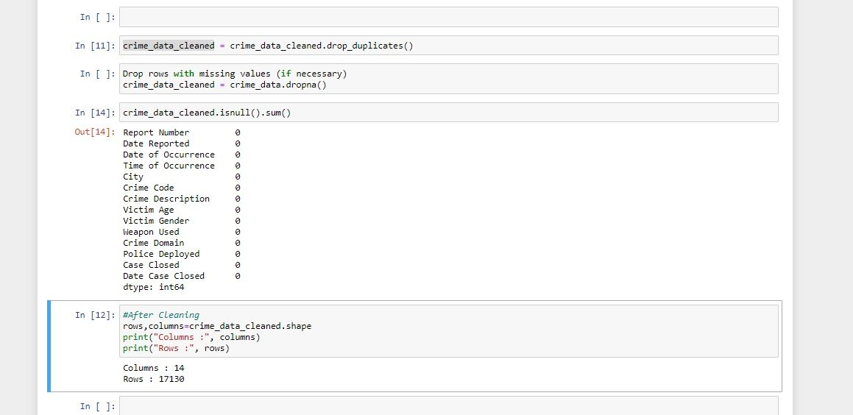
Remove Unnecessary Columns & Null Values
CRIME RATE PREDICTION
10.11.2024

Slide 25


HYPOTHESIS
Defining Hypothesis
Implementation of hypothesis
CRIME RATE PREDICTION
10.11.2024

Slide 26
5. Hypothesis
5.1 Defining Hypothesis
Victim Gender and Crime Types: Female victims are more frequently targeted in harassment and assault, while males face higher rates of violent crimes like robbery and homicide.
Crime Rates in Indian Cities: Highly urbanized cities like Delhi and Mumbai report significantly higher crime rates than smaller cities.
City and Crime Type: Non-violent crimes are more common in larger cities, while violent crimes are evenly spread across both large and small cities.
Police Deployment by Crime: Violent crimes and traffic fatalities demand larger police deployments, especially in cities like Delhi and Bangalore.
Crime Concentration in Cities: Crime is more concentrated in metro areas like Delhi and Mumbai, with smaller cities experiencing lower crime rates.
CRIME RATE PREDICTION
10.11.2024

Slide 27
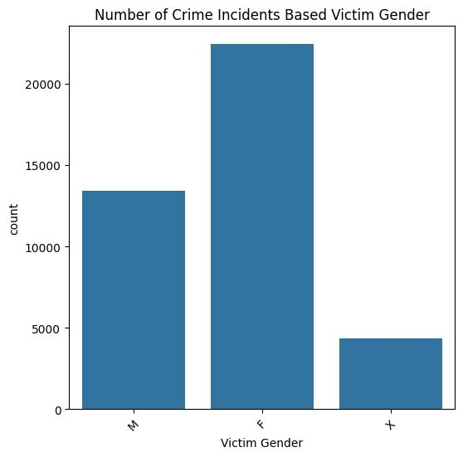
5.2 Implementation of Hypothesis
5.2.1 Bar Graph
Crime Incidents Based on Victim Gender
CRIME RATE PREDICTION
10.11.2024

Slide 28
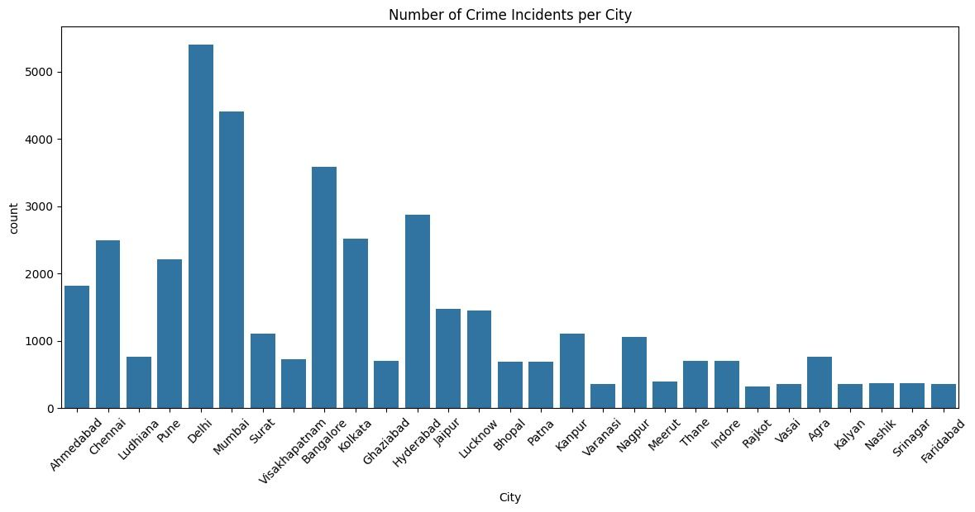
5.2.2 Bar Graph
Crime Incidents Across Indian Cities
CRIME RATE PREDICTION
10.11.2024

Slide 29
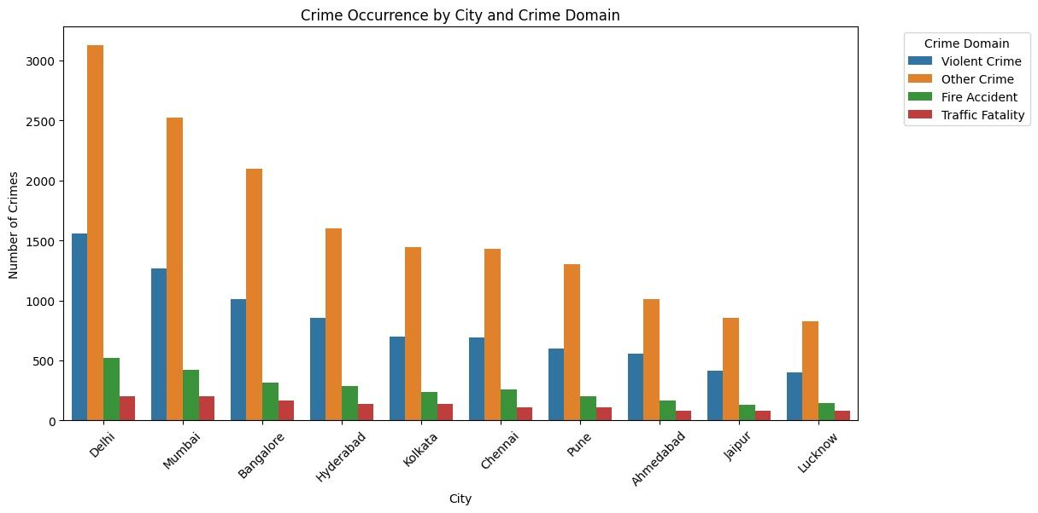
5.2.3 Bar Graph
Crime Occurrence by City and Crime Domain
CRIME RATE PREDICTION
10.11.2024

Slide 30
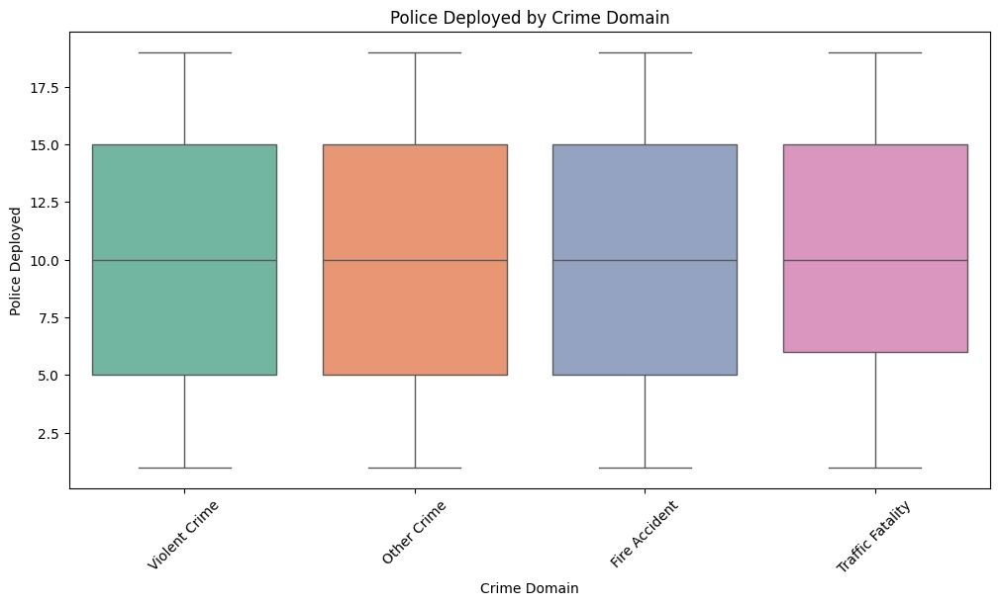
5.2.4 Box Plot
Police Deployment Based on Crime Domain
CRIME RATE PREDICTION
10.11.2024

Slide 31
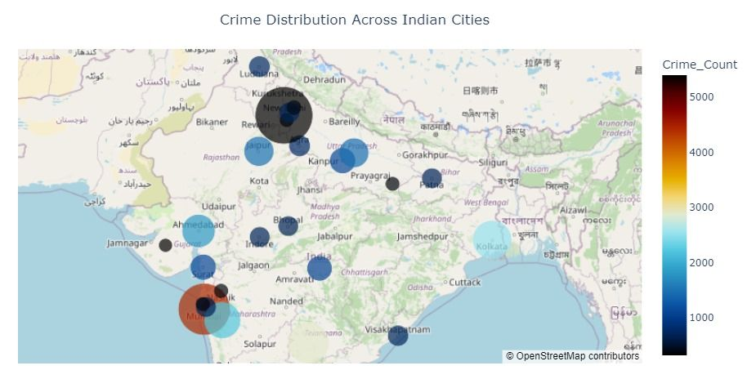
5.2.4 Map Visualization
Crime Distribution Across Indian Cities:
CRIME RATE PREDICTION
10.11.2024

Slide 32
DATA MODELLING
CRIME RATE PREDICTION
10.11.2024

Slide 33


6. Modelling
I. Linear Regression :-
Linear regression is probably one of the most important and widely used regression techniques. It’s among the simplest regression methods. One of its main advantages is the ease of interpreting results
6.1 Data Modelling
Data modelling is the process of creating a structured representation of relationships between various features and crime rates in different cities. The goal of this project is to use historical crime data to predict future crime trends using various machine learning models. The models used include both linear and non-linear approaches to improve prediction accuracy. Below are the models applied to the crime data:
II. Random Forest :-
A random forest is a meta estimator that fits a number of classifying decision trees on various sub-samples of the dataset and uses averaging to improve the predictive accuracy and control over-fitting
CRIME RATE PREDICTION
10.11.2024

Slide 34
a
III. K-Nearest Neighbors (KNN)
K-Nearest Neighbours (KNN) is a non-parametric algorithm that predicts the output by averaging the values of the k nearest data points in the feature space. It is simple and effective, especially for smaller datasets and where the relationships between variables are less complex.
IV. Decision Tree Regressor
Decision Tree is a simple, intuitive model that splits data into subsets based on feature values. It recursively breaks down the data into branches, forming a tree structure that makes predictions based on the outcome at the leaf nodes..
CRIME RATE PREDICTION
10.11.2024

Slide 35
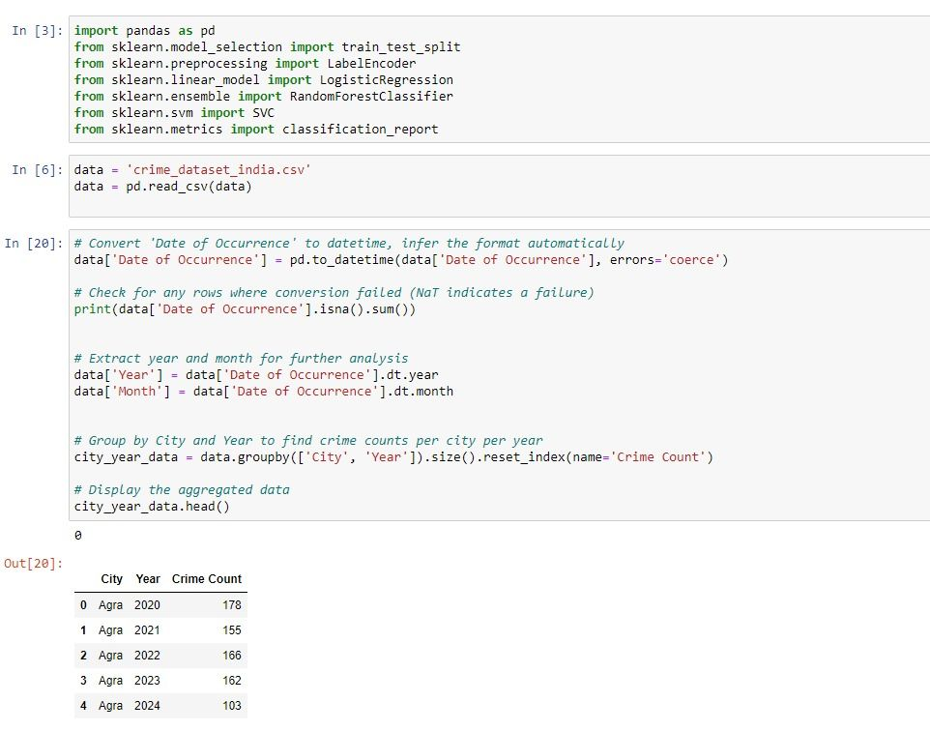
6.2 Data Preprocessing
Splitting Data by Year and Month
CRIME RATE PREDICTION
10.11.2024

Slide 36
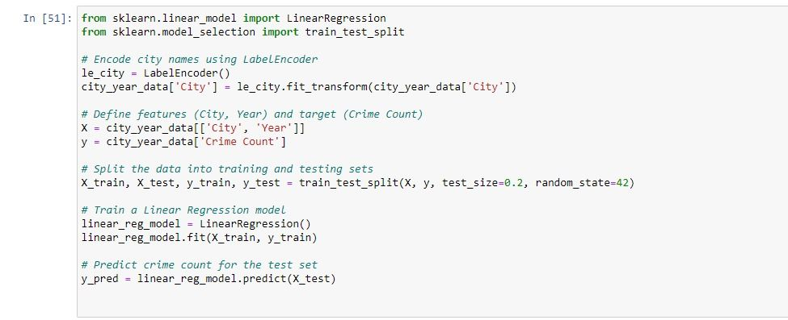
Encoding Categorical Data
CRIME RATE PREDICTION
10.11.2024

Slide 37
6.3. Model Implementation
I . Linear Regression
Description: Linear Regression is one of the simplest regression techniques that assumes a linear relationship between the features and the target variable (crime rate).
Implementation: The model was applied to the crime dataset, using features such as population density, crime type, and previous crime rates to predict future crime rates.
Results: The model provided moderate accuracy, but due to the complexity of the data and the presence of non-linear relationships, Linear Regression did not perform as well as expected.
Accuracy: 94%
CRIME RATE PREDICTION
10.11.2024

Slide 38
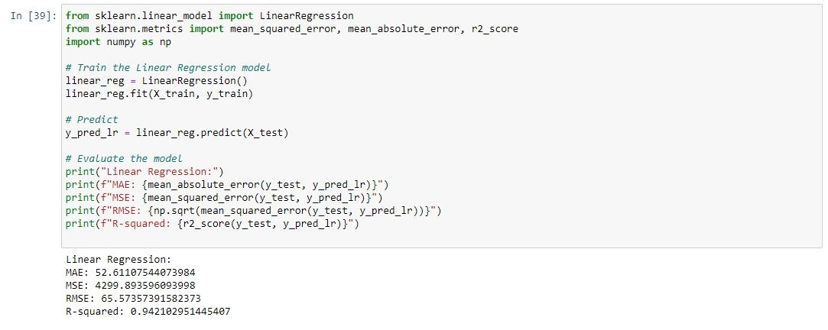
I . Linear Regression
CRIME RATE PREDICTION
10.11.2024

Slide 39
II . Random Forest Regressor
Random Forest Regressor :
Description: Random Forest is an ensemble model that constructs multiple decision trees on various sub-samples of the dataset and averages their predictions to improve accuracy and reduce overfitting.
Implementation: Random Forest was applied to the crime dataset to account for the complex, non-linear relationships between variables. By using multiple decision trees, the model was able to capture more detail and improve overall predictive accuracy.
Results: Among the three models, Random Forest showed the best performance, achieving the highest accuracy. It effectively handled the complexities of the dataset, such as interactions between crime type, location, and demographics.
Model Accuracy: 96%
CRIME RATE PREDICTION
10.11.2024

Slide 40
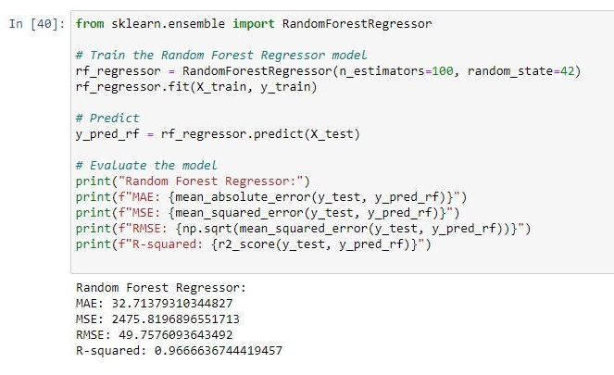
II . Random Forest Regressor
CRIME RATE PREDICTION
10.11.2024

Slide 41
III. K-Nearest Neighbors (KNN):
Description: KNN is an instance-based learning algorithm that predicts outcomes based on the k-nearest data points in the feature space. It is useful for capturing local patterns but struggles with complex datasets.
Implementation: Applied to the crime dataset, KNN used features like crime type, location, and previous incidents to predict future crime rates. The number of neighbors (k) was tuned for optimal results.
Results: KNN provided reasonable performance but underperformed on the complex, non-linear crime data.
Accuracy: 24%
CRIME RATE PREDICTION
10.11.2024

Slide 42
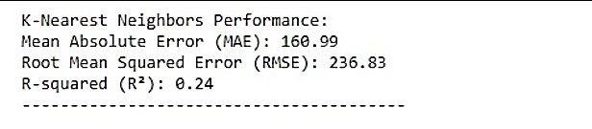
III. K-Nearest Neighbors (KNN):
CRIME RATE PREDICTION
10.11.2024

Slide 43
IV. Decision Tree (chosen model):
Description: Decision Tree is a regression model that splits the dataset into smaller subsets based on feature values, creating a tree structure. It is effective in capturing both linear and non-linear relationships.
Implementation: Applied to the crime dataset, the model used features such as crime type, location, and previous crime rates to predict future crime incidents. It handled complex relationships and provided interpretable results.
Results: The Decision Tree model achieved high accuracy due to its ability to handle the non-linear nature of crime data.
Accuracy: 97%
CRIME RATE PREDICTION
10.11.2024

Slide 44
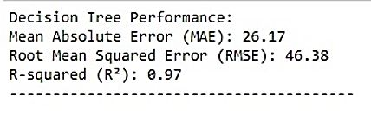
IV. Decision Tree (chosen model):
CRIME RATE PREDICTION
10.11.2024

Slide 45
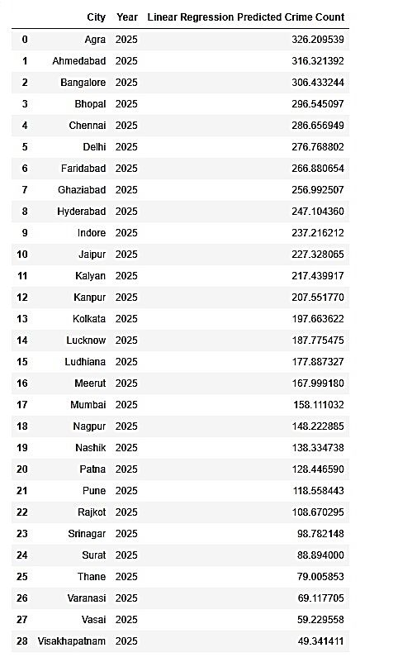
6.4. Prediction Results
I. Linear Regression Model Predictions:
CRIME RATE PREDICTION
10.11.2024

Slide 46
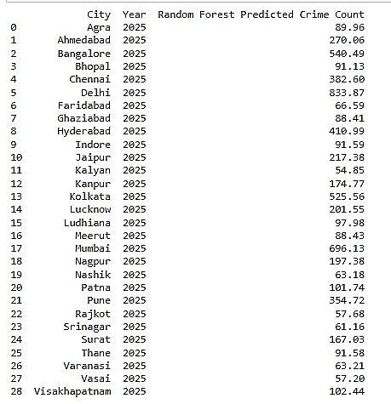
II. Random Forest Regressor Model Predictions:
CRIME RATE PREDICTION
10.11.2024

Slide 47
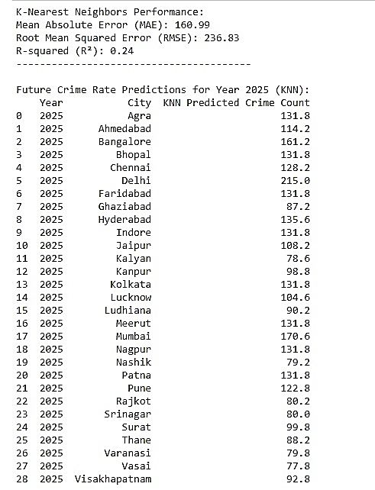
III. K-Nearest Neighbors (KNN) Model Predictions:
CRIME RATE PREDICTION
10.11.2024

Slide 48
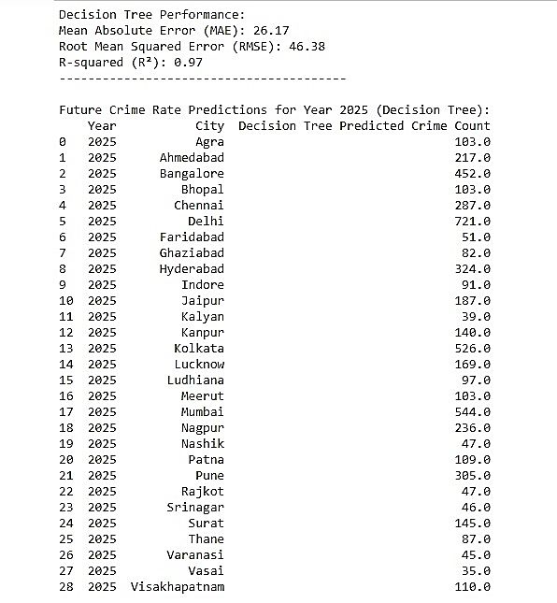
IV. Decision Tree Model Predictions:
CRIME RATE PREDICTION
10.11.2024

Slide 49


CONCLUSION
CRIME RATE PREDICTION
10.11.2024

Slide 50

7. Conclusion
The "Crime Rate Prediction and Trend Analysis" project successfully utilized historical crime data from various Indian cities to predict future crime rates and trends. The project implemented several machines learning models, including K-Nearest Neighbors (KNN), Linear Regression, and Decision Tree, to predict crime occurrences and understand crime patterns. The Decision Tree model was chosen as the final model due to its high accuracy of 97%, outperforming the other models in handling the complex relationships present in the dataset.
By leveraging data visualization and predictive modeling techniques, the project provides valuable insights for law enforcement agencies. It highlights cities with the highest crime rates (e.g., Delhi and Mumbai) and identifies factors such as victim age, gender, crime type, and police resource allocation. These findings can assist authorities in optimizing resource management and developing targeted crime prevention strategies.
CRIME RATE PREDICTION
10.11.2024

Slide 51
8. Future Direction
The "Crime Rate Prediction and Trend Analysis" project has built a solid foundation for predictive crime analytics, but there is potential for further improvement. Future efforts could focus on incorporating more diverse data sources, such as socioeconomic factors and real-time data from social media, to refine the prediction models. Additionally, geospatial analysis, which maps crime occurrences to specific areas, and time-series forecasting could enhance predictive accuracy. Real-time model deployment, allowing law enforcement agencies to act on predictions proactively, and improving model interpretability using techniques like SHAP or LIME for better decision-making could also be valuable directions. Finally, deploying the model as a web or mobile app could give law enforcement real-time access to insights for crime prevention.
CRIME RATE PREDICTION
10.11.2024

Slide 52

THANK YOU
CRIME RATE PREDICTION
10.11.2024

